Slide 1
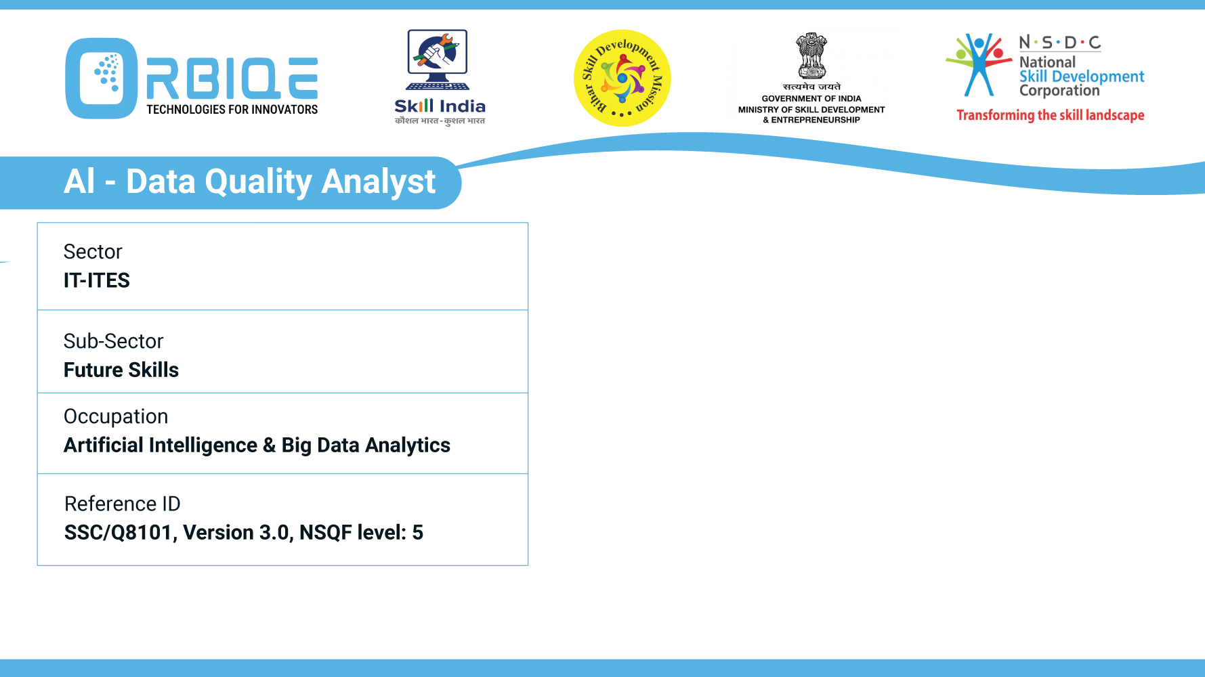


Name- Krishna Kant Dubey

Slide 2

Identify correlation between variables using scatterplots and other graphical techniques

Slide 3
Agenda
Correlation between variables is a key step in exploratory data analysis (EDA), and scatterplots and other graphical techniques

Slide 4
Scatterplots: The Go-To Tool for Correlation
What It Shows:
Relationship between two continuous variables.
Direction (positive/negative), strength, and linearity of correlation.
Pattern | Meaning
Points form an upward slope | Positive correlation (e.g., height vs. weight)
Points form a downward slope | Negative correlation (e.g., age vs. reaction time)
Points are scattered randomly | No correlation
Points curve or cluster non-linearly | Non-linear relationship (e.g., quadratic or exponential)

Slide 5
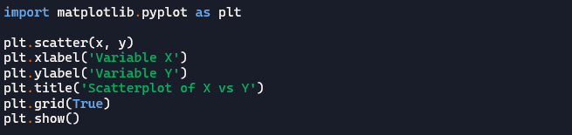
Scatterplots: The Go-To Tool for Correlation Example (Python with matplotlib)

Slide 6

Heatmaps of Correlation Matrices
What It Shows:
Pairwise correlation coefficients (e.g., Pearson’s r) between multiple variables
Color-coded matrix for quick visual comparison

Slide 7
Pair Plots(Scatterplot Matrix)
What It Shows:
Multiple scatterplots for all variable pairs.
Histograms or KDE plots on the diagonal

Slide 8
Bubble Charts
What It Shows:
Scatterplot with a third variable represented by bubble size or color.
Adds dimensionality to correlation analysis.
Use Case:
Visualizing sales vs. marketing spend, with bubble size as customer count

Slide 9
Line Plots & Time Series Graphs
What It Shows:
Correlation over time between variables
Useful for trend analysis and lagged relationships

Slide 10
Thank You

